Slide 1
The role of requirements in the success or failure of software projects.
Arooj kousar
Bscs-f19-m5
B

Slide 2
Introduction
Requirement is a statement about a proposed system
requirement has to do with capturing the objectives and the purpose of a system.
It is the conditions or the capability needed by users to solve problems or meet their objectives.
Requirement is a key factor during every software development as it describes what different stakeholders need and how the system will satisfy these needs.
expressed in natural language so that everyone can understand .
It helps the analyst to better understand which elements and functions are necessary in the development of a particular software project.

Slide 3
background
Year | Author | Methodology | Conclusion
2016 | Dr. Sohail Asghar & Mahrukh Umar | Requirement Engineering Process | In future, we will be looking forward to prioritize these challenges by calculating the impact of each challenge on development of software applications.

Slide 4
background
Year | Author | Methodology | Conclusion
2007 | Cheng, B.H.C., Atlee, J.M. | requirements engineering | In conclusion, the RE research community has made significant progress along many fronts.For these reasons, it is an exciting time to be involved in RE research.

Slide 5
background
Year | Author | Methodology | Conclusion
2016 | Azham Hussain, Emmanuel Mkpojiogu | kano method | :This paper reveals that 80% of requirements for the proposed design are one-dimensional. This indicates that these requirements are quality enhancer and they can proportionately increase the satisfaction of users

Slide 6
background
Year | Author | Methodology | Conclusion
2018 | Donald C Gause Gerald M. Weinberg | :Context-Free Process Questions | Context-free questions often reveal conflicting assumptions among various interested parties

Slide 7
background
Year | Author | Methodology | Conclusion
2018 | Emmanuel O. C. Mkpojiogu, and Azham Hussain | Kano questionnaire | user reported requirements importance ratings highly accounts for the variations in perceived customer satisfaction

Slide 8
Method
RE is one of the branches of software engineering.
it is a practical and systematic approach through which the software or system engineer collects functional or non-functional requirements from different customers/clients for the design and development of quality software products
It is the systematic processes and techniques for requirements elicitation, requirement analysis, specification, verification and management of requirements

Slide 9
Method
RE process is divided into two main set of activities; namely,
requirements development
requirement management
There are many reasons for software project failures; however, poorly engineered requirements process contributes immensely to the reason why software projects fail.
Software projects failure are usually costly and risky and could also be life threatening.

Slide 10
evaluation
A successful software project is one that is completed on time and within allocated budget, and which has all the originally specified features and functions.
challenged project is one that is completed but with time and budget overrun and also with fewer features and functions when compared to those originally specified.
A failed project is one that is aborted or cancelled before its completion. It is also one that is completed, but never implemented.

Slide 11
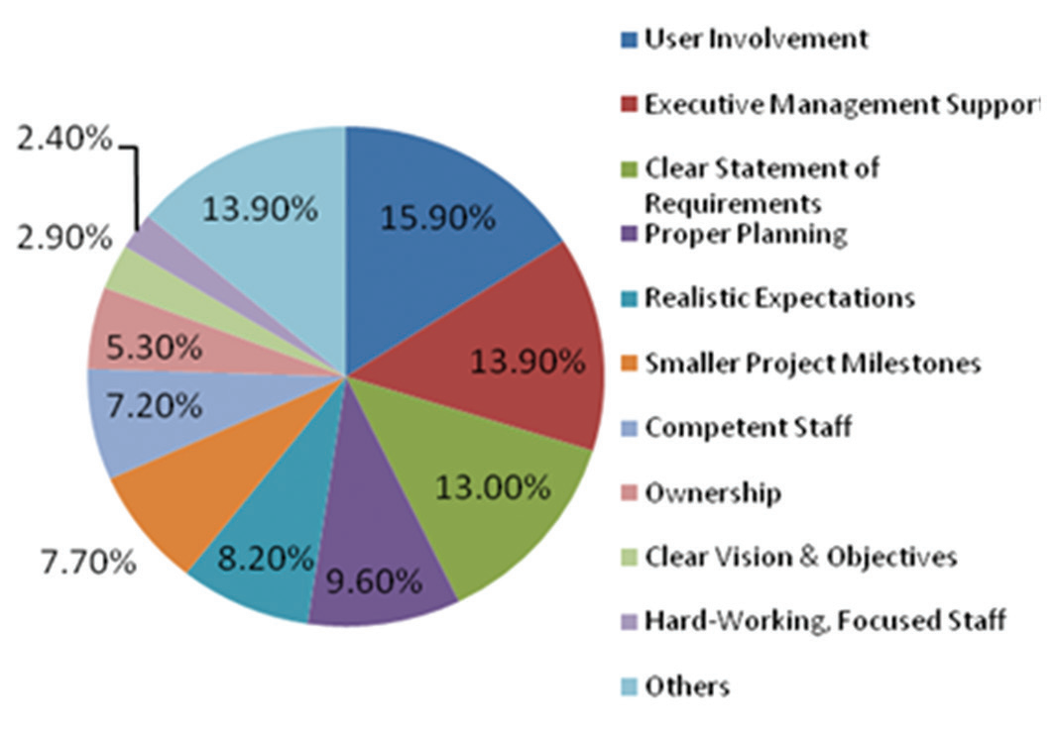
Project success factors
In the Figure 1, user involvement (15.90%), executive management support (13.90%) and clear statement of requirements (13%) are the top three factors responsible for project success.

Slide 12
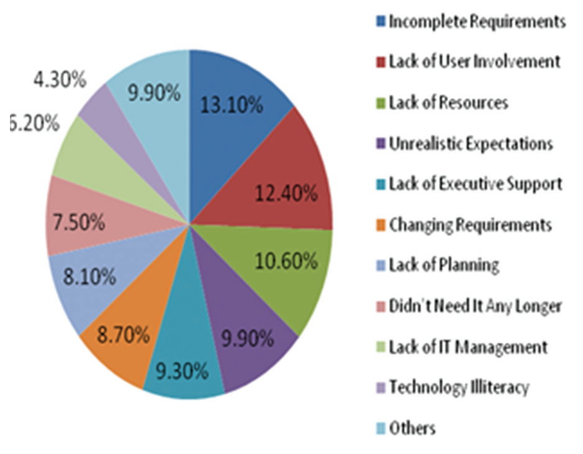
Project failure factors
incomplete requirements (13.10%), lack of user involvement (12.40%), and lack of resources (10.60%) are the top three factors causing impaired or failed projects.

Slide 13
Conclusion
In conclusion, the success or failure of any given software development project hinges on how the software requirements process was carried out.
The cost or the risks involved in a poorly engineered requirements process are great and sometimes irreparable.
RE stands as a bedrock upon which the success of software projects stands.
colossal wastes can be avoided if adequate attention is given to proper RE in all software development projects.

Slide 14
the end
thank you!

